Slide 1
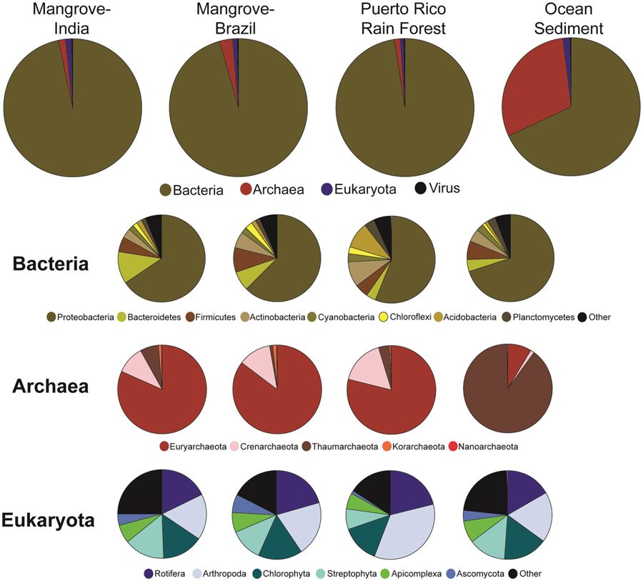
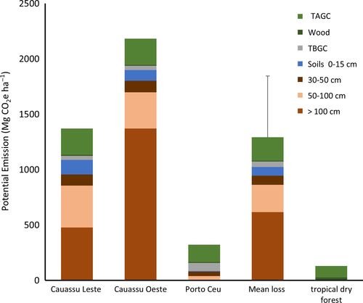
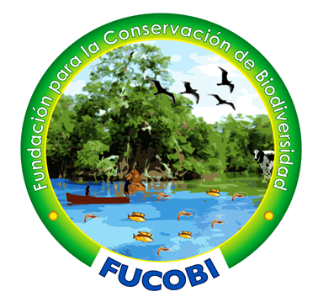
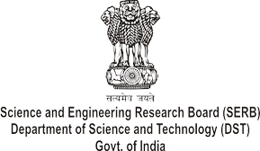
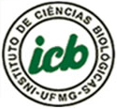
MICROBIAL COMMUNITIES FROM MANGROVES SOIL AND THE INFLUENCE OF CONVERSION TO SHRIMP PONDS ON CARBON STOCK AND GREENHOUSE GAS EMISSIONS
AQUACULTURE 2019
Marcus Vinicius Canário Viana^{1,2}*, Madangchanok Imchen³, Ranjith Kumavath³, Debmalya Barh^{1,4,5}, Aline Vaz⁶, Aristóteles Góes-Neto⁶, Sandeep Tiwari¹, Preetam Ghosh⁷, Artur Silva², Alice R. Wattam⁸, and Vasco Azevedo¹
¹Laboratory of Cellular and Molecular Genetics, Department of General Biology, Institute of Biological Sciences, Federal University of Minas Gerais, Belo Horizonte, Minas Gerais, Brazil; ²Laboratory of Bioinformatics, Institute of Biological Sciences, Federal University of Pará, Belém, Pará, Brazil; ³Department of Genomic Science, School of Biological Sciences, Central University of Kerala, Kerala, India; ⁴Centre for Genomics and Applied Gene Technology, Institute of Integrative Omics and Applied Biotechnology, Nonakuri, Purba Medinipur, West Bengal, India; ⁵Division of Bioinformatics and Computational Genomics, NITTE University Center for Science Education and Research, Deralakatte, Mangaluru, Karnataka, India; ⁶Molecular and Computational Biology of Fungi Laboratory, Department of Microbiology, Institute of Biological Sciences, Federal University of Minas Gerais, Belo Horizonte, Minas Gerais, Brazil; ⁷Department of Computer Science Virginia Commonwealth University, Virginia, USA; ⁸Biocomplexity Institute, Virginia Tech University, Blacksburg, Virginia, USA.
Author’s email: canarioviana@gmail.com
REVIEW
Mangrove forest ecosystems have been characterized in relation to microbial communities, ecosystem services and ecological impacts after conversion to other land uses. Its microbial communities are essential for biogeochemical cycles and biocycling of most nutrients. With the goal of identifying the microbial signatures, we used whole metagenome next generation sequencing to compared metagenomes from sediment samples from four different locations within a vast mangrove system in Kerala (India) to other known mangrove data, tropical rainforest and ocean sediment¹. Across the mangroves, Bacteria were the predominant organisms, with Proteobacteria as the dominant phylum, followed by Bacteroidetes, Firmicutes and Actinobacteria (Figure 1). Principal component analysis grouped the mangrove forests and the rainforest samples. At the highest taxonomic levels, the forest samples had similar taxonomic patterns and the ocean was distinctly different, with 12.9% of archeal sequencing reads in comparison to less than 5% of the forests. The groups also differ in Archaea composition, the predominant phylum was Euryarchaeota for forest and Thaumarchaeota for ocean samples.
Mangrove forests provide many ecosystem services, including sequestering large quantities of carbon in soils. The conversion to shrimp ponds influence carbon stocks and potential greenhouse gas emissions, as shown in a comparison of eight mangrove forests and three shrimp ponds from the northeast region of Brazil². The mean carbon stock of the mangroves was 413 ± 94 Mg C/ha. The conversion resulted in losses of 58%–82% of the ecosystem carbon stocks and mean emissions of 1,390 Mg CO₂e/ha, 81% from soil. The losses were estimated to be 10-fold greater than emissions from slash and burn of the upland tropical dry forests from the northeast region (142.7 Mg CO₂e/ha) (Figure 2). This underscored the value of including of mangroves in climate change mitigation programs and suggested weighting its ecosystem services against the short-term values of production of an export food for developed nations.
Mangrove is one of the ecosystems studied by the Brazilian Microbiome Project³, a local initiative that aims to coordinate national microbiome research, integrated with international initiatives, and provide user-friendly open source bioinformatics tools and human resources training for microbiome data analyses. The research aims to develop strategies to “(a) mitigate environmental greenhouse gas emissions; (b) increase the activity of beneficial microorganisms from humans to soils; (c) suppress pathogenic microorganisms in plants and humans; (d) understand the impact of pollutants in aquatic environments; and (e) create a rapid and efficient strategy for scientific and technological bioprospecting”. Due to ecological and economic roles of mangroves, we expect an increase in collaboration of research groups from different countries.
Figure 1. Taxonomic structure at the highest taxonomic levels across all metagenome samples. Averages of reads across samples from the same geographic location are pictured, with diversity at the kingdom level (large circles), different phyla within those kingdoms (smaller circles), and classes presented (Source: Imchen et al., 2017).
Figure 2. The potential cumulative carbon emissions (Mg CO₂e/ha) from conversion of mangroves to shrimp ponds, and
upland dry forest to shifting cultivation, Ceará, Brazil (TAGC = Total above ground carbon pool and TBGC = total below ground plant carbon pool) (Source: Kauffman et al., 2018).
REFERENCES
ACKNOWLEDGMENTS
Imchen, M., et al. (2017): Searching for signatures across microbial communities: Metagenomic analysis of soil samples from mangrove and other ecosystems. Scientific Reports, v. 7, p. 8859. doi: 10.1038/s41598-017-09254-6.
Kauffman, J.B., et al. (2018): Shrimp ponds lead to massive loss of soil carbon and greenhouse gas emissions in northeastern Brazilian mangroves. Ecology and Evolution, v. 8, p. 5530–5540. doi: 10.1002/ece3.4079.
Pylro, V., Roesch, L. The Brazilian Microbiome Project. In: Pylro V, Roesch L, editors. The Brazilian Microbiome. 1st ed. Cham: Springer International Publishing; 2017. pp. 1–6. doi:10.1007/978-3-319-59997-7_1.

